Slide 1
Pharmacotherapy in acute coronary syndromes
Perspective from first line and regional hospitals in Czech Republic
Petr Jansky
Cardionale, 26.11.2010

Slide 2
Pilot MI registry (n=3188)
6 non PCI hospitals
Discharge pharmacotherapy
Svobodová, 2008

Slide 3
CZECH registry
All ACS patients
11/2005
N 1921
1/ all PCI hospitals (80%)
2/ all community hospitals
in two regions (20%)
Widimský P. et al., Int J Cardiol, 2007

Slide 4
Discharge pharmacotherapy STEMI
%
Mandelzweig, EHJ, 2006
Widimský, Int J Cardiol, 2007

Slide 5
Discharge pharmacotherapy nonSTE ACS
%
Widimský, Int J Cardiol, 2007

Slide 6
Recommendations for performance measures
Development of regional and/or national programmes to systematically measure performance indicators and provide feedback to individual hospitals is strongly encouraged (I-C).
European Heart Journal, July 2007

Slide 7
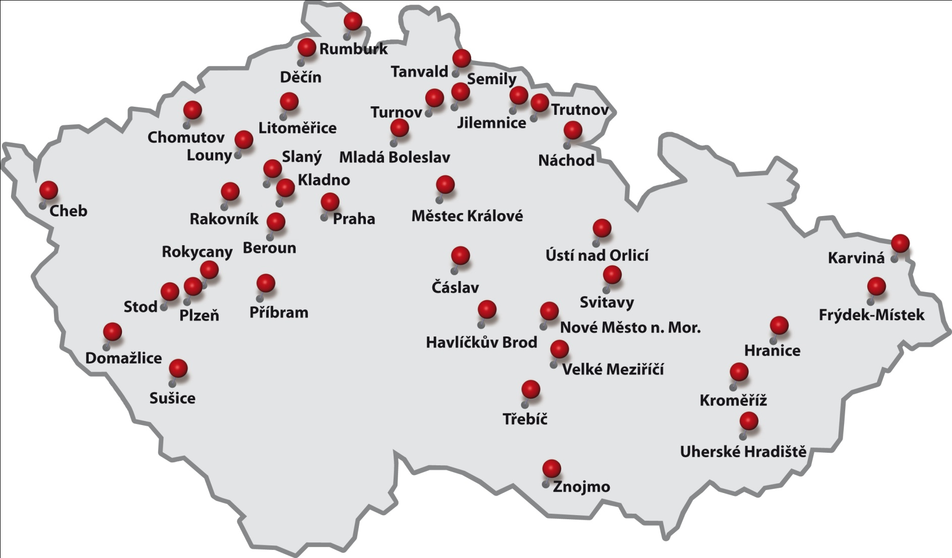

Slide 8

Confirmed acute coronary syndromes
(STEMI, NONSTEMI, unstable AP)
Continually since 1.7.2008
32 non cath hospitals

Slide 9
Quality of pharmacotherapy
Prehospital phase
Early hospital phase
On discharge

Slide 10
Patient characteristics 7/2008-3/2010
 |  |  |  | Mean age ± SD
 | n | % STEMI | % males | males | females
 | 3995 | 27,5 | 60,6 | 66,8 ± 12,4 | 74,2 ± 11,0

Slide 11
Prehospital pharmacotherapy

Slide 12
Prehospital pharmacotherapy
EMS vs physician

Slide 13
Prehospital pharmacotherapy

Slide 14
Evidence-based medical therapy
(heparin, ASA, BB, statin, thienopyridin) within the first 24 hours after admission is associated with lower in-hospital mortality in NSTEMI
%
N 1889, p < 0,001
Monhart et al., ESC 2008

Slide 15
Aspirin
Pharmacotherapy within 24 hours after admission
Linear trend: n.s.

Slide 16
Betablockers
Pharmacotherapy within 24 hours after admission
Linear trend: n.s.

Slide 17
ACEI
Pharmacotherapy within 24 hours after admission
Linear trend: n.s.

Slide 18
Clopidogrel
Pharmacotherapy within 24 hours after admission
Linear trend: p=0,023

Slide 19
Statin
Pharmacotherapy within 24 hours after admission
Linear trend: p<0,001

Slide 20
LMWH
Pharmacotherapy within 24 hours after admission
Linear trend: n.s.

Slide 21
Heparin
Pharmacotherapy within 24 hours after admission
Linear trend: p=0,036

Slide 22
Fondaparinux
Pharmacotherapy within 24 hours after admission
Linear trend: p=0,011

Slide 23
Pharmacotherapy within 24 hours after admission
% | Males | Females | <=70 y | >70 y | STEMI | NSTEMI
Aspirin | 90,8 | 88,4 | 92,7 | 87,4*** | 92,9 | 89,7*
Clopidogrel | 69,6 | 60,8** | 74,2 | 58,9*** | 77,4 | 65,4***
Heparin | 25,8 | 19,6* | 28,2 | 19,1*** | 53,5 | 16,0***
LMWH | 60,7 | 65,5 | 59,8 | 65,2 | 42,3 | 66,2***
BB | 66,6 | 65,1 | 67,6 | 64,6* | 52,1 | 67,7***
Fondaparinux | 16,0 | 15,2 | 16,3 | 15,0 | 9,3 | 19,5***
ACEI | 59,6 | 60,2 | 60,1 | 59,5 | 47,3 | 60,3***
Statin | 66,6 | 64,1 | 70,2 | 61,6*** | 53,8 | 65,6***
* p<0,05; ** p<0,01; *** p<0,001

Slide 24
Aspirin
Discharge pharmacotherapy
Linear trend: n.s.

Slide 25
Clopidogrel
Discharge pharmacotherapy
Linear trend: n.s.

Slide 26
Clopidogrel on discharge – individual hospitals

Slide 27
Betablockers
Discharge pharmacotherapy
Linear trend: n.s.

Slide 28
Betablockers on discharge – individual hospitals

Slide 29
ACEI
Discharge pharmacotherapy
Linear trend: p=0,012

Slide 30
Statin
Discharge pharmacotherapy
Linear trend: p<0,001

Slide 31
Combination
(aspirin, clopidogrel, BB, ACEI, statin)
Discharge pharmacotherapy
Linear trend: p=0,010

Slide 32
Discharge pharmacotherapy
% | Males | Females | <=70 y | >70 y | STEMI | NSTEMI
Aspirin | 93,5 | 91,6 | 95,6 | 89,9*** | 96,6 | 92,5***
Clopidogrel | 74,2 | 62,9*** | 78,5 | 60,9*** | 87,3 | 71,6***
BB | 85,2 | 83,4 | 86,0 | 83,0* | 86,1 | 84,0
ACEI | 79,8 | 77,6 | 79,9 | 78,1 | 82,3 | 77,0**
Statin | 89,7 | 85,4 | 92,3 | 83,6*** | 91,4 | 85,7**
* p<0,05; ** p<0,01; *** p<0,001

Slide 33
Conclusion
Unsatisfactory prehospital pharmacotherapy
In-hospital pharmacotherapy is relatively good
(exc. elderly, females, NONSTEMI)
Interhospital variability in the quality of care
Improvement in some recommended therapies (statins, clopidogrel in the acute phase) over short time period

Slide 34
Thank you for your attention !

